Slide 1
University Result Management System
716_A

Slide 2
Problem statement
To develop a system that will manage
Information about various students and their subjects
Student can view his/her results and can raise an
issue regarding marks through a dedicated
option with which he/she can contact the
faculty of that subject directly.
Faculty has an option to upload a screenshot
as a proof to the student who raised issue

Slide 3
Agenda
Introduction
Features
Tools
Languages used
Objective
Scope
Implementation
Conclusion

Slide 4


Introduction
The project titled “University result management system” is a web based application which is used to maintain results of the students.
This project contains two modules. Admin login module and student login module. Admin module is used to add the results of students and student module is used to provide the results and can download results.
Registered users can access the database of students.

Slide 5
Features
Proper log-in System
Password protected and only accessible to faculties and students
Add and manage students and declare results
Calculate scores, percentages and Grades
Request for re-evaluation
View semester results from anywhere using smart devices

Slide 6
-------
Tools
Languages used
Visual studio code,
Mysql
Html
Css
Java
Javascript
Reactjs

Slide 7
Objective
The main objective of University result management system is to manage the grades/results of various examinations and courses of the students.
This can be an important part of learning as it helps in evaluating progress.
The most significant advantage of university result management system is that it can be used efficiently by the university as well as students.
The purpose of this project is to build an application to reduce manual work for managing the result.

Slide 8
Scope
This application will manage information of various students enrolled in different courses in different years.
The system makes overall results management much easier and flexible.
It can be accessed over internet.
There is no risk of data mismanagement at any level while the project development is under process.
It provides high level of security using different protocols like https etc.

Slide 9
Implementation
Admin module
Student module
Add new students and their results
Add and manage courses to the students
Can declare and edit results of the student
Maintain personel information
Login using their uid and password
Can view results
Can raise an issue to the faculty directly through the website.
Can print results

Slide 10
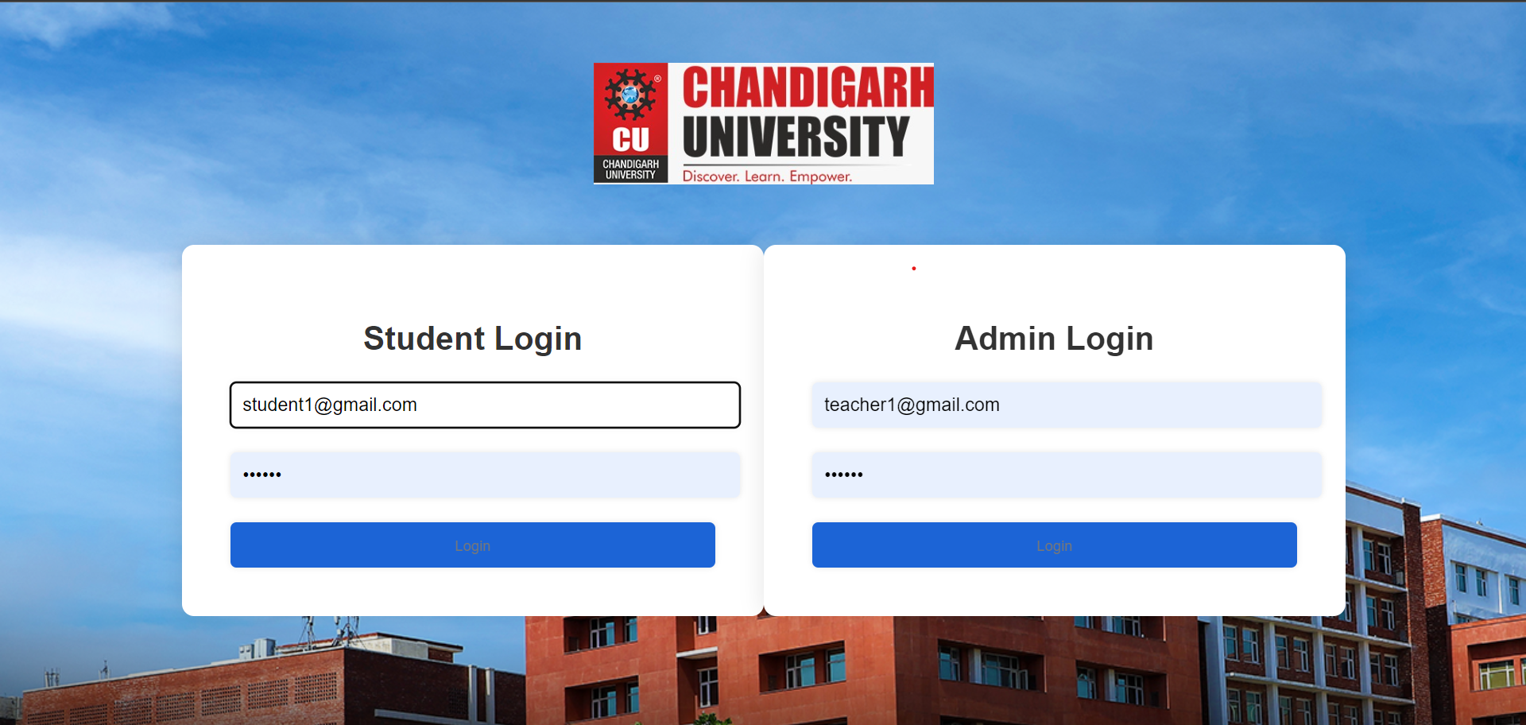
Admin and Student Login

Slide 11
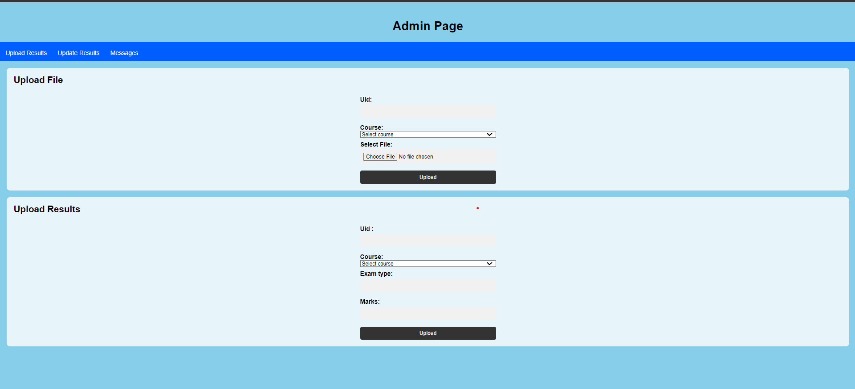
Admin Page

Slide 12
Admin Page

Slide 13
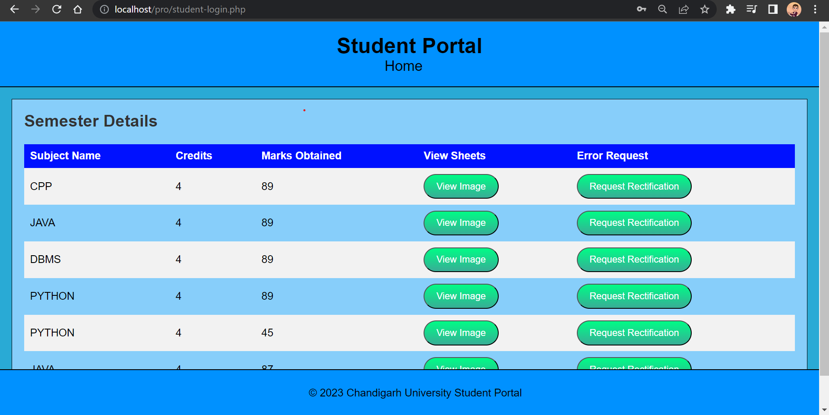
Student Dashboard

Slide 14
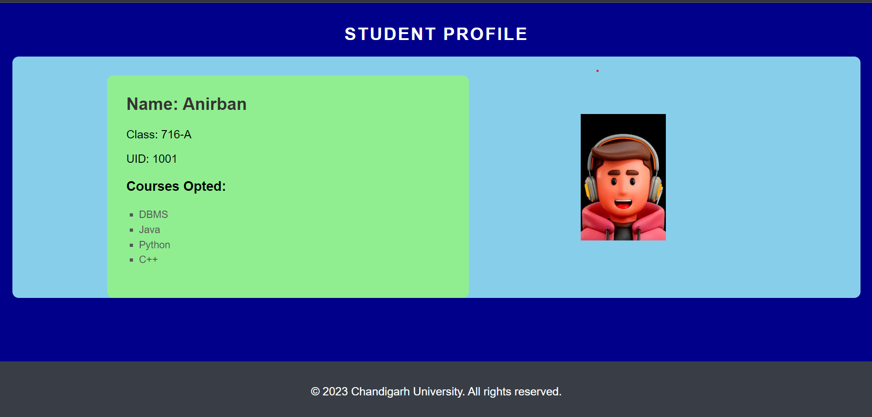
Student Profile

Slide 15
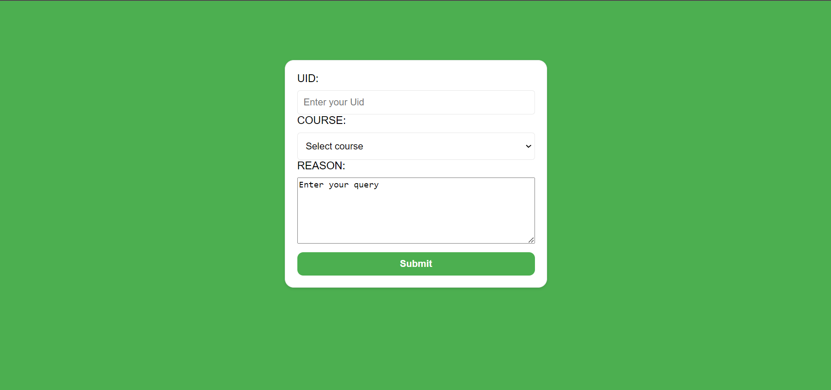
Rectification Page

Slide 16
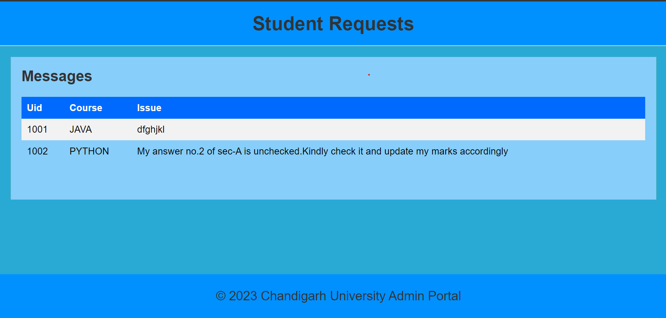
Rectification requests

Slide 17
Team
Our Team
Anirban
Nithin
Sudhanshu
Garvit
Rajneesh

Slide 18
Timeline
Front-end of all web pages
30-03-2023
1
Frame work of all web pages
10-03-2023
2
Back-end using PHP and MySQL
20-04-2023
3
A fully responsive website which is ready to serve
30-04-2023
4

Slide 19
Thank you

